Slide 1




Dayananda Sagar University (DSU) - Main Campus
School of Engineering
Devarakaggalahalli, Harohalli, Kanakapura Road, Bengaluru South Dist., Karnataka 562112
DEPARTMENT OF COMPUTER SCIENCE AND ENGINEERING
(ARTIFICIAL INTELLIGENCE AND MACHINE LEARNING)
Capstone Project Phase-II (22AM4801)
External Review
Title: “Semantic Similarity Based Academic Descriptive Answer Evaluator Leveraging Machine Learning and Business Intelligence”
Under the Supervision of
Dr. Jitendra Jaiswal, Associate Professor
Prof. Mitha Guru, Assistant Professor
Department of CSE (AI&ML)
SOE, DSU.
Team Members:
Manideep Tatikonda ENG22AM0194
Arjun Pulivarthi ENG22AM0076
B Abhishek Roy ENG22AM0170
Swettha M A ENG22AM0165
Academic Year: 2025-2026

Slide 2
Contents
Conference Paper Details
Problem Statement
Objectives
Final Methodology / Approach
Performance Metrics and Graphical Results
References
Executable Code

Slide 3
Conference Name and Publishment
Conference Name:
5th MAHSA International Conference on Industrial Revolution, Information & Communication Technology (Mi-IRICT 2025)
Conference Website Link :
https://mahsaacademy.com.my/conference/MAHSA%20Conferences/MiIRICT25/miirict.html
Indexing:
979-8-3315-6997-6/26/$31.00 ©2026 IEEE
DOI: 10.1109/IMED68921.2026.11484884

Slide 4
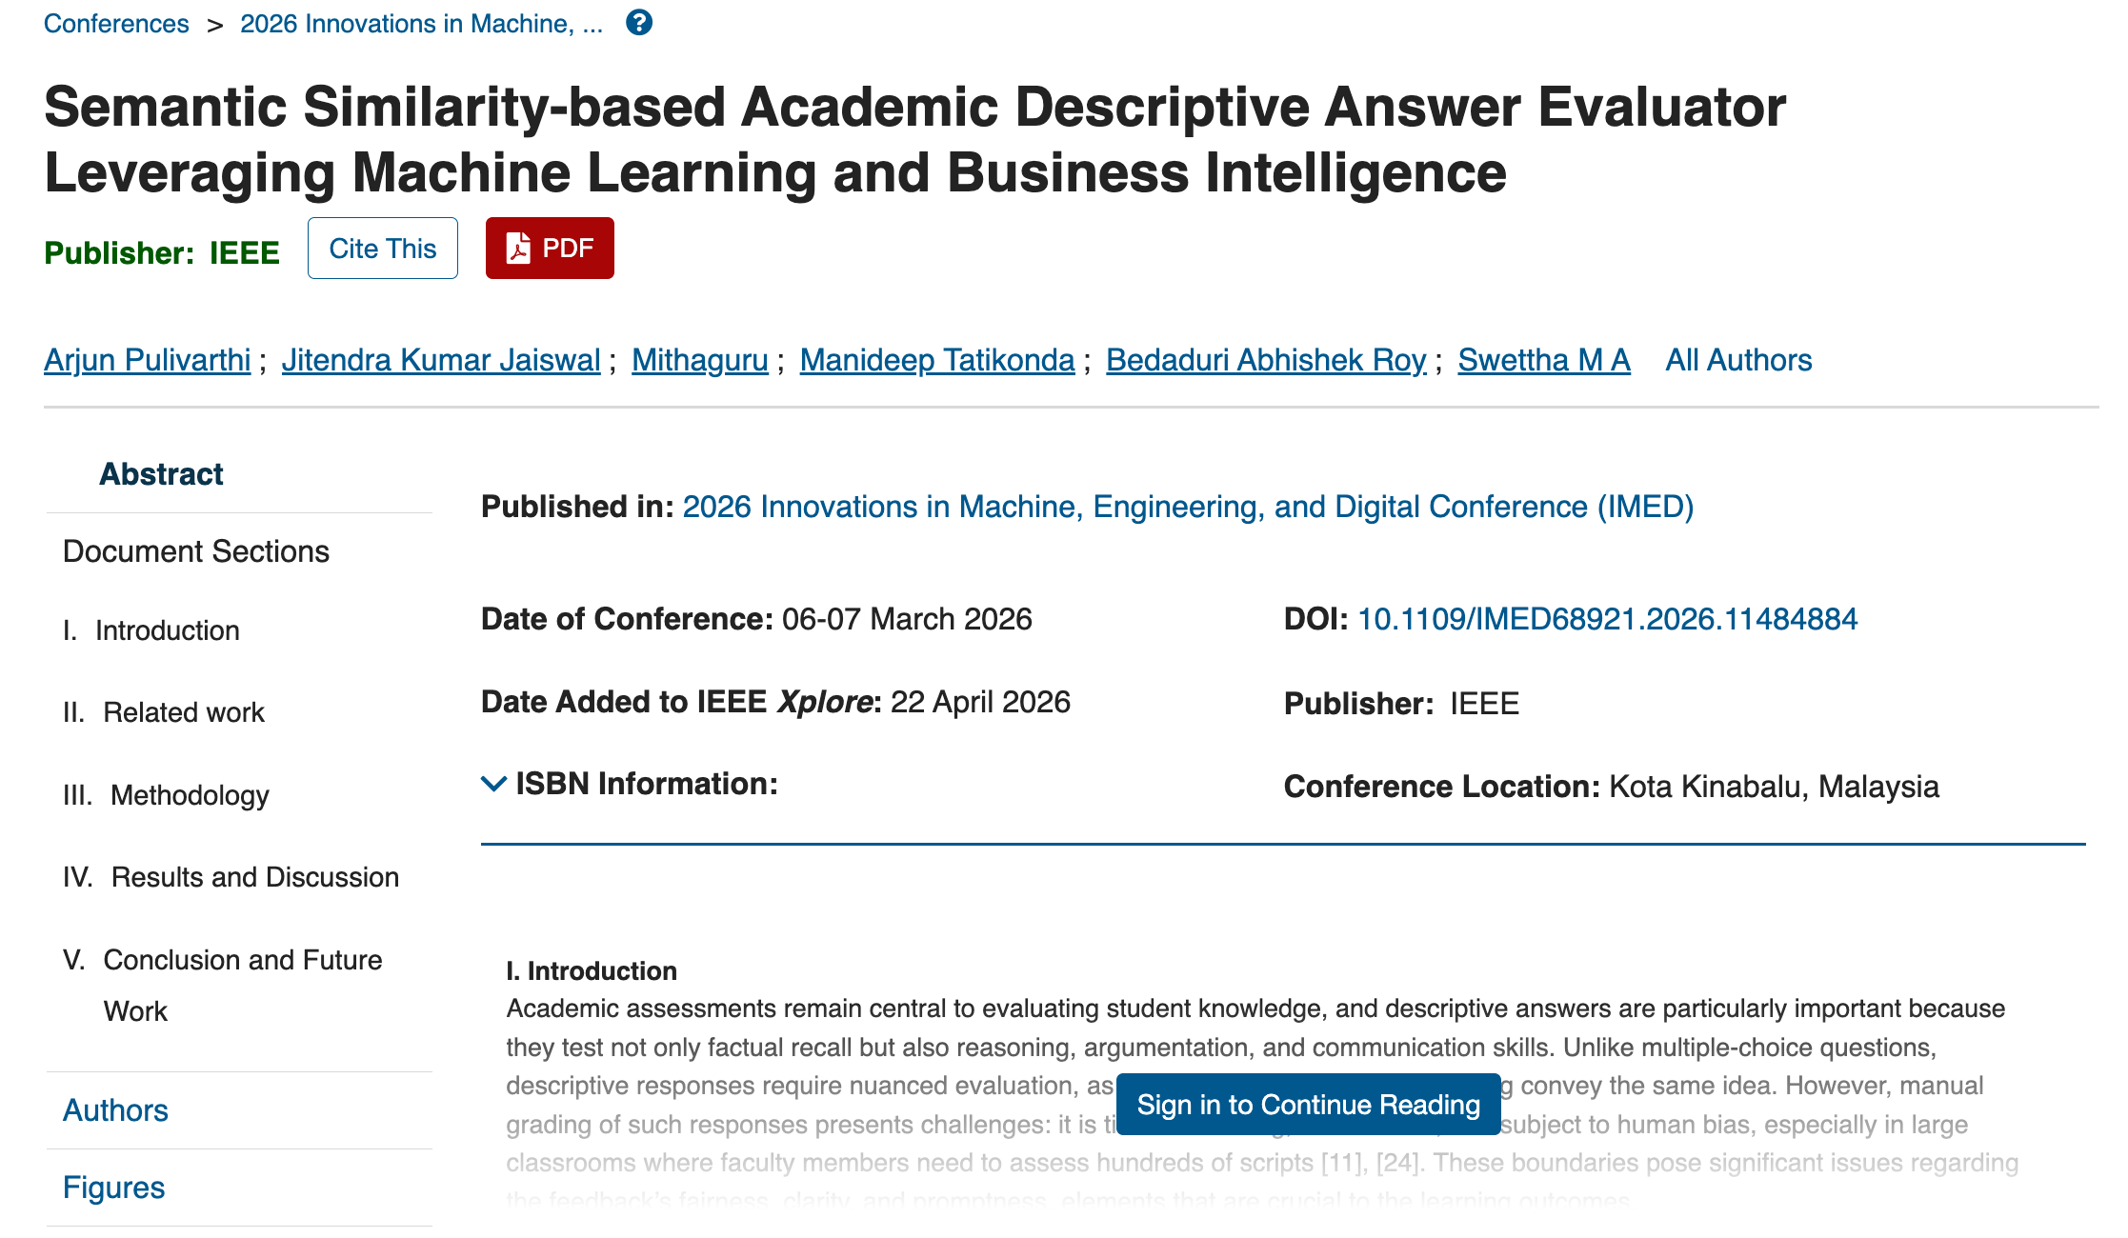
Publishment Notification
https://ieeexplore.ieee.org/document/11484884

Slide 5
Introduction and SDG
Manual Evaluation Delays
Inconsistent Human Grading
Lack of Semantic Understanding
Limited Transparency in Scoring
Absence of Cognitive-Level Analysis
Bias in Traditional Evaluation
SDG 4 – Quality Education
SDG 9 – Industry, Innovation and Infrastructure
SDG 10 – Reduced Inequalities
SDG 16 – Peace, Justice and Strong Institutions

Slide 6
Problem Statement
Descriptive answer evaluation in academics is time-consuming, inconsistent, and subjective.
Manual grading struggles with fairness, bias, and scalability as class sizes grow.
Traditional automated systems rely on keyword matching, ignoring the actual meaning of answers.
Faculty also lack tools for plagiarism detection and Bloom’s Taxonomy-based performance insights.
Hence, an AI-assisted system is needed to ensure semantic understanding, transparency, and faster evaluation.

Slide 7
Objectives
Automate grading of descriptive answers using semantic similarity techniques.
Map questions to Bloom’s Taxonomy for cognitive skill analysis.
Integrate Explainable AI (XAI) to justify grading decisions.
Detect plagiarism within and across student responses.
Provide BI dashboards for faculty to visualize results and insights.

Slide 8
Base Paper and Novelty
Paper Title | Algorithm | Dataset | Metrics | Research Gap
Automatic Grading System Using Sentence-BERT Network (Ndukwe et al., 2020) | SBERT (Transformer) | Networking course short answers | QWK ≈ 0.70 (good agreement with human raters) | Limited evaluation across domains; lacks feedback mechanism
Automatic Short Answer Grading using BERT + Deep Learning (Gupta & Ekbal, 2021) | BERT + DL Classifier | Custom student answer datasets | Accuracy ≈ 85–90% | Focuses only on grading, not on plagiarism or bias
Question Classification using TF-IDF + Word2Vec (Mohammed & Omar, 2020) | TF-IDF + Word2Vec + SVM | 600 exam questions (multi-domain) | F1 ≈ 89% | Limited to question classification; not integrated with grading
TrOCR: Transformer-based OCR (Li et al., 2023) | Transformer OCR | IAM Handwriting DB | Outperforms CNN-RNN OCR (≈85–90% accuracy for neat handwriting) | Still weak on cursive/low-quality handwriting
ASAG with Feedback (Aggarwal et al., 2023, EngSAF Dataset) | LLM Fine-tuned (7B) | 5.8k engineering answers (EngSAF) | ~75% grading accuracy; feedback rated 4.5/5 | Feedback not yet domain-specific; limited large-scale deployment

Slide 9
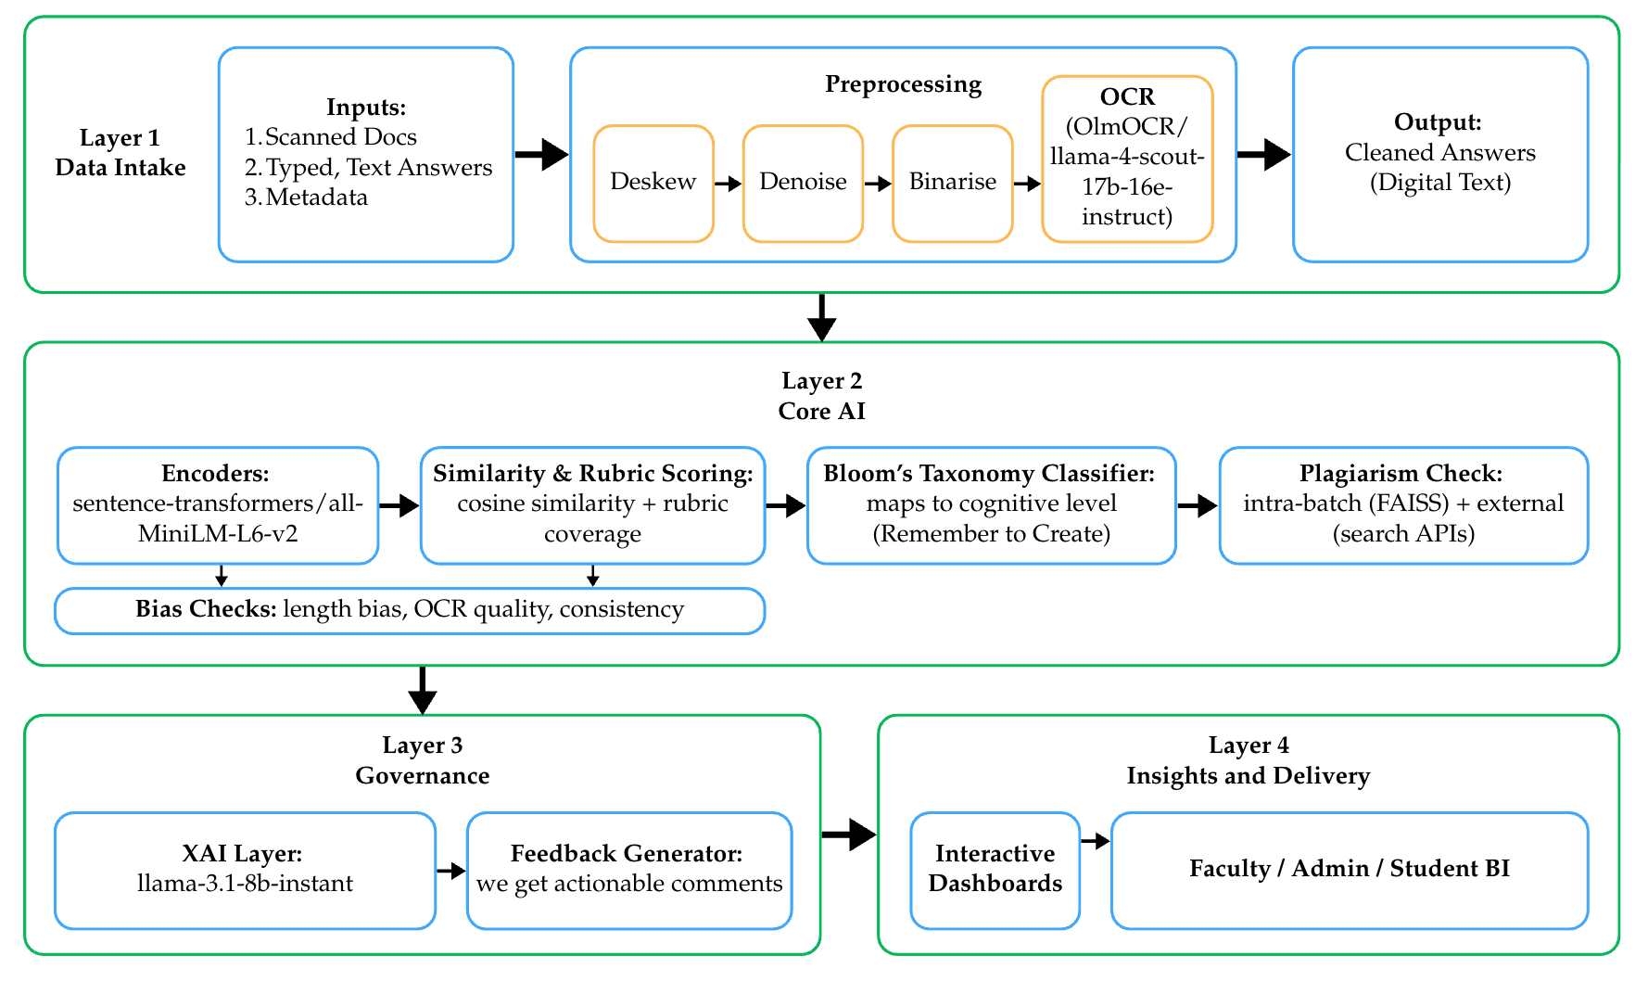
Architectural Diagram / Methodology

Slide 10
Results and Observation
Metric | Value | Interpretation
Pearson Correlation (r) | 0.8717 | Strong agreement with human grading
MAE | 1.109 | Avg error ≈ 1 mark on 5-mark scale
RMSE | 1.382 | Penalizes larger grading mistakes
R² Score | 0.309 | ~31% variance in scores
Accuracy (±1 mark) | 54.5% | 1 in 2 predictions close to human score
Bias | -1.109 | Slight under-scoring tendency
Confidence Score | 0.942 | High evaluation confidence
Originality Score | 93% | 7% plagiarism detected

Slide 11
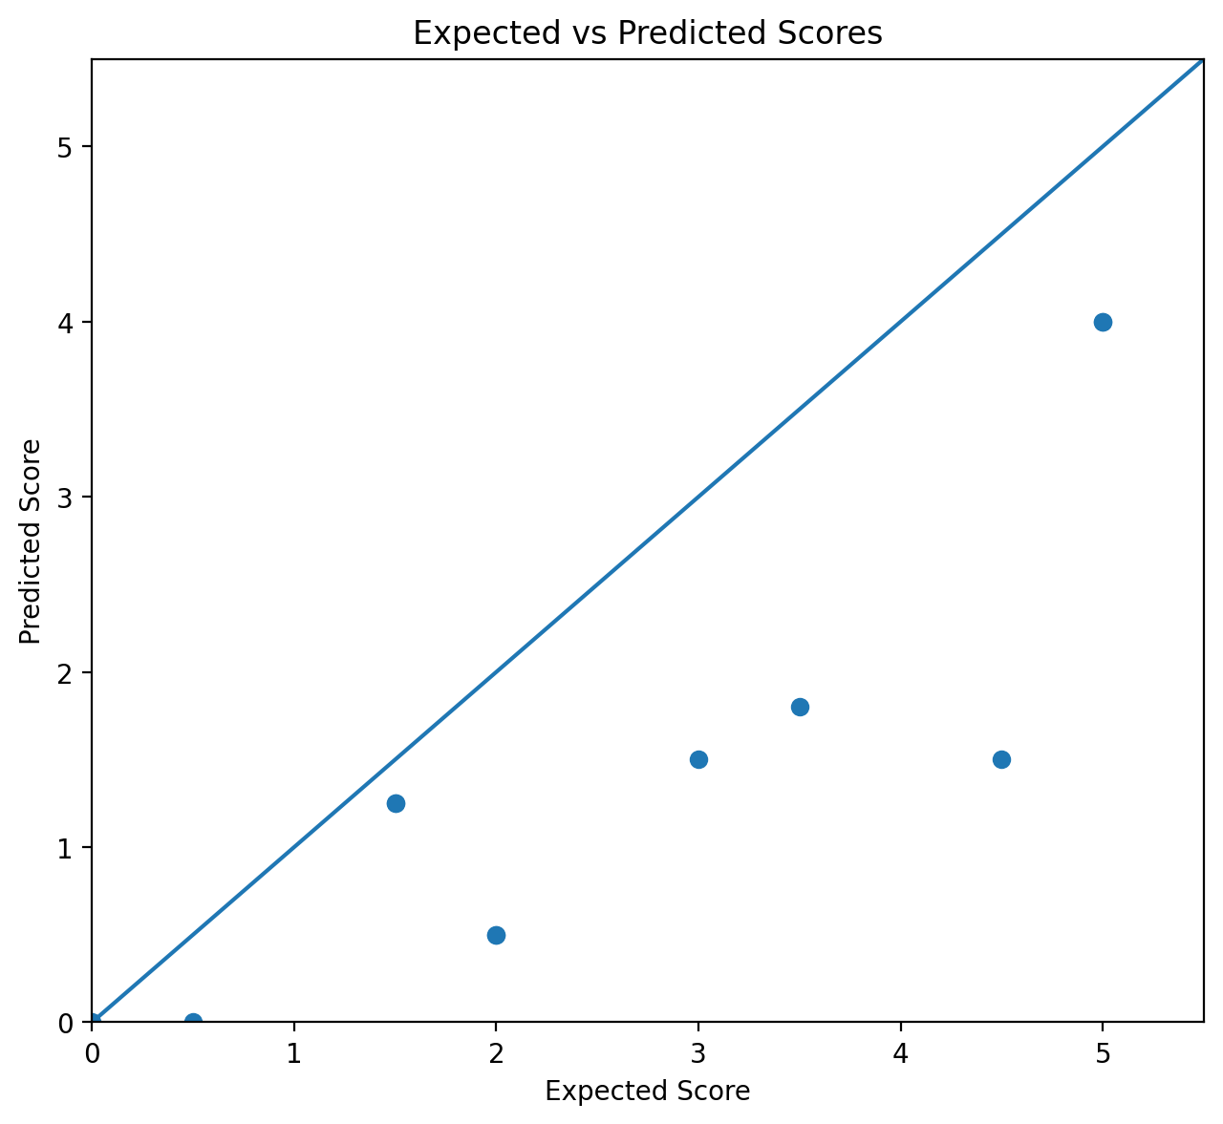
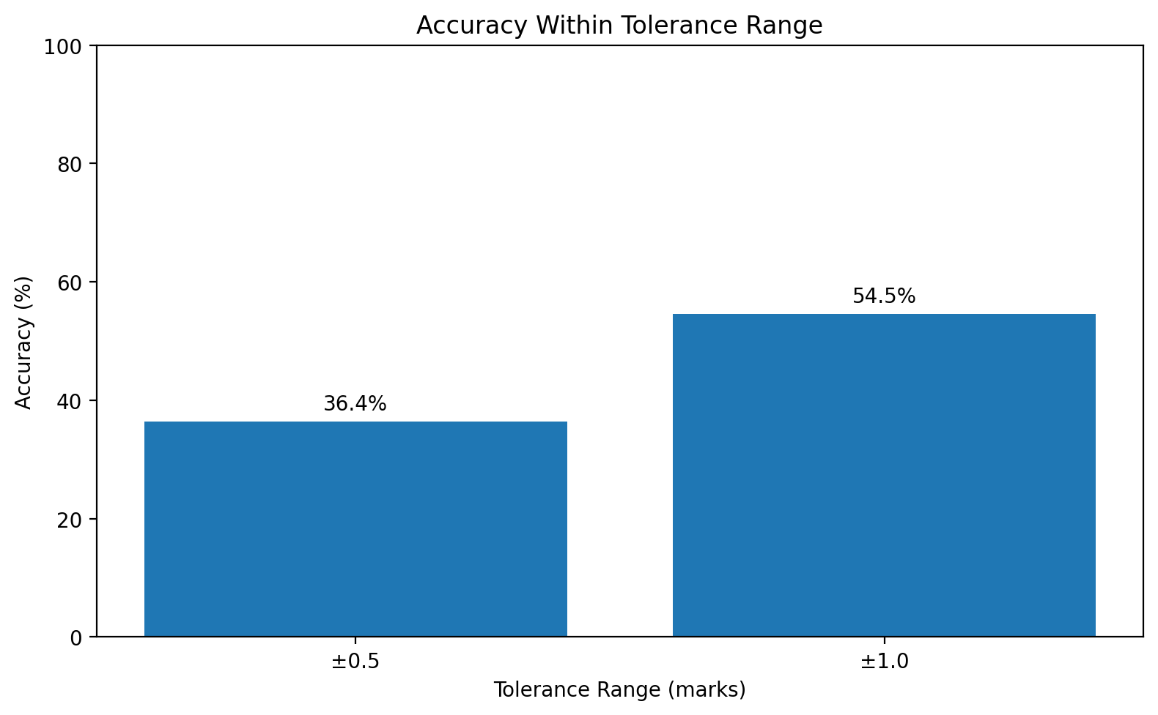
Results and Observation

Slide 12
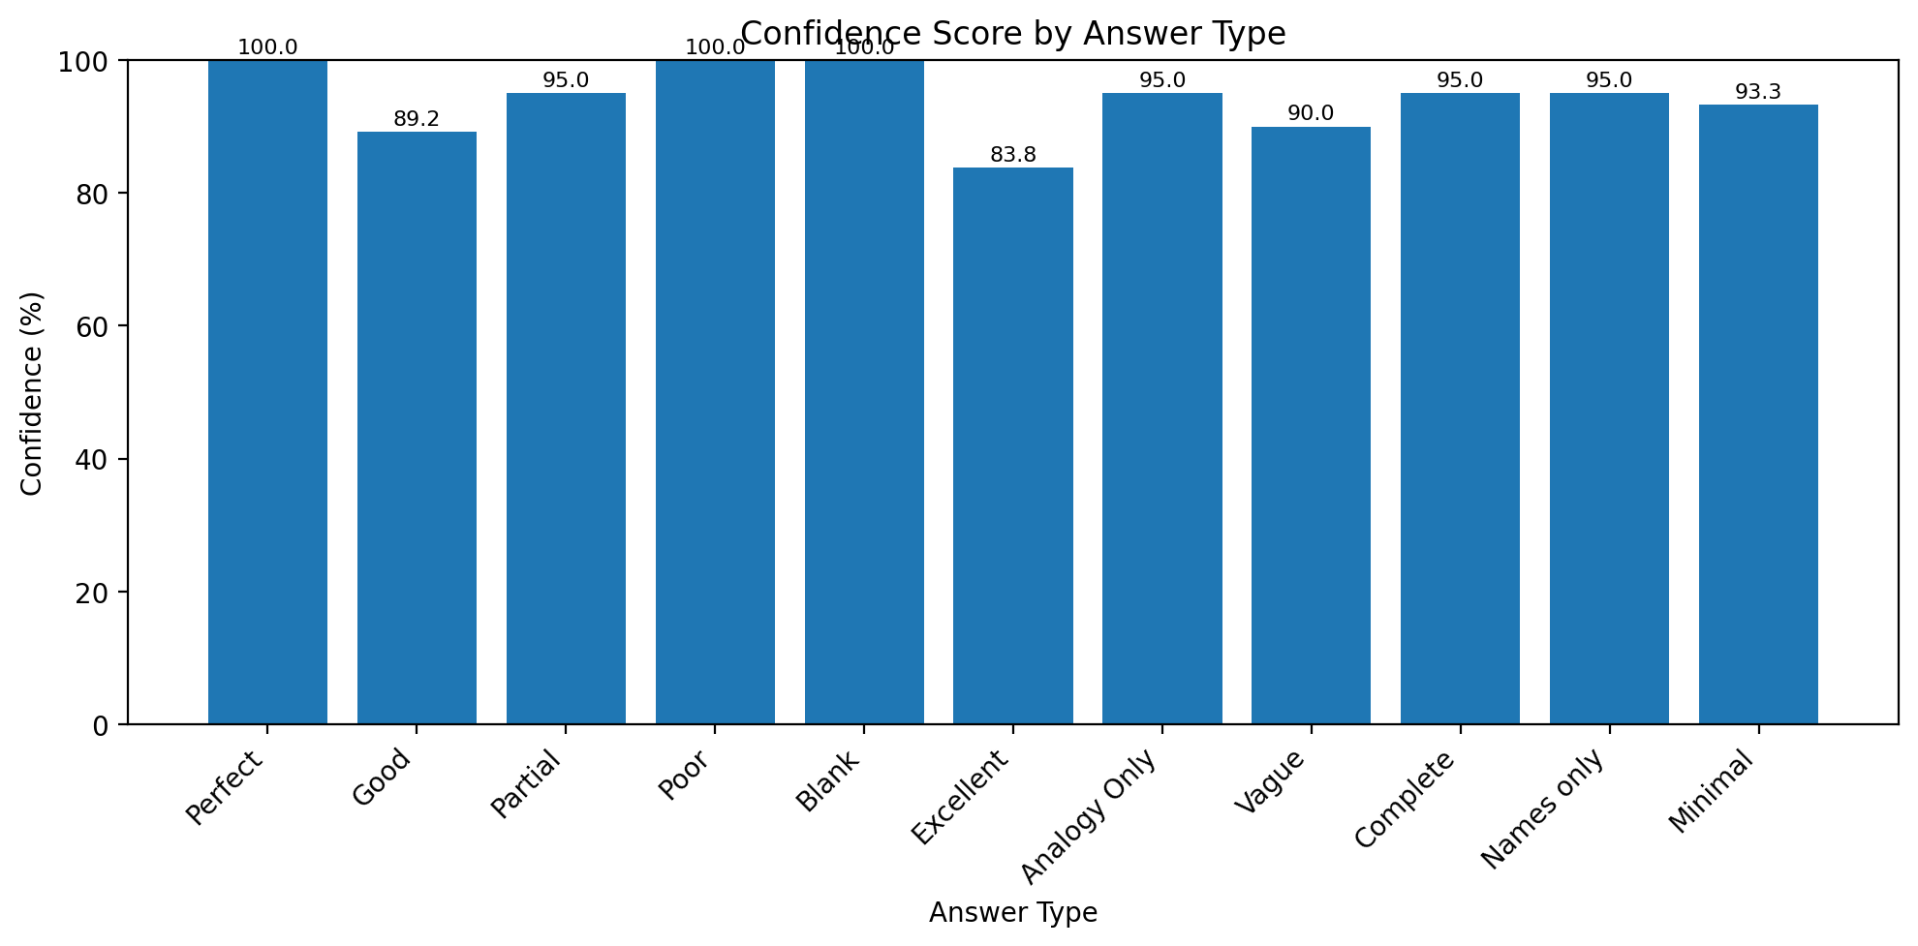
Results and Observation

Slide 13
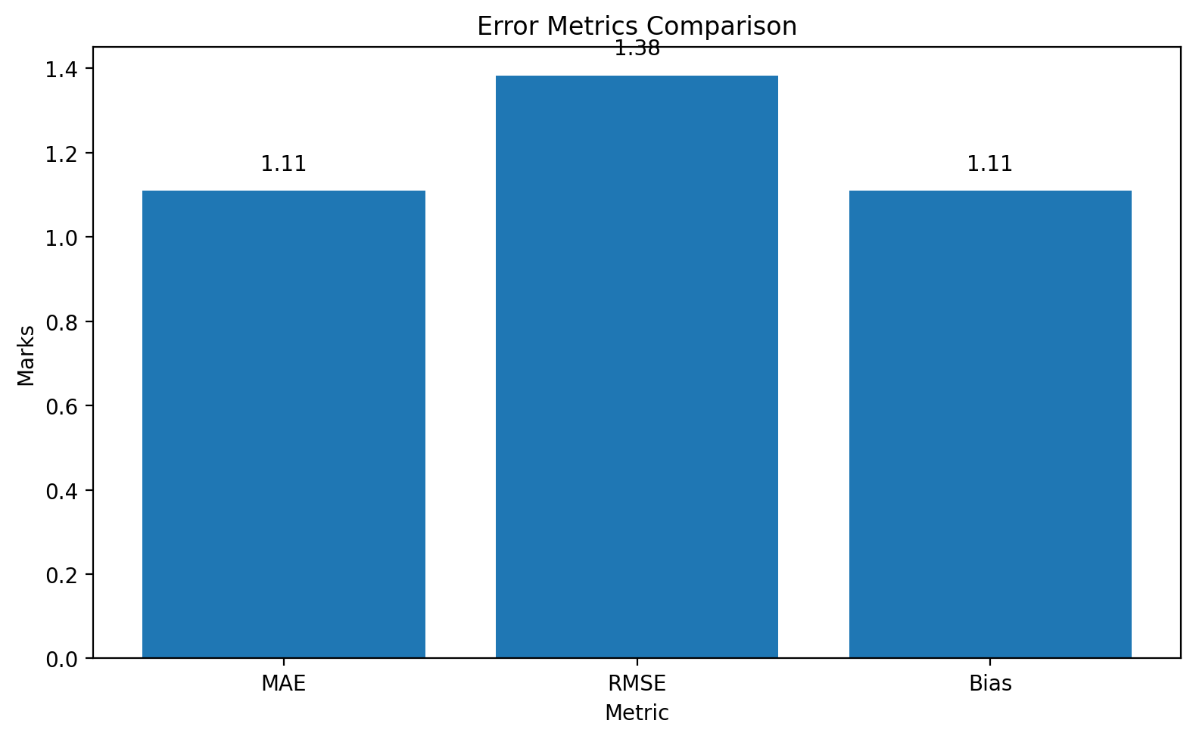
Results and Observation

Slide 14
Working Screenshot
https://unigrid.kyneticlabs.in

Slide 15
References - 1
[1] J. Devlin, M. Chang, K. Lee, and K. Toutanova, “BERT: Pre-training of Deep Bidirectional Transformers for Language Understanding,” Proc. NAACL-HLT, pp. 4171–4186, 2019.
[2] N. Reimers and I. Gurevych, “Sentence-BERT: Sentence Embeddings using Siamese BERT-Networks,” Proc. EMNLP-IJCNLP, pp. 3982–3992, 2019.
[3] A. Gupta and M. Lehal, “A Survey of Text Plagiarism Detection Techniques,” Journal of Emerging Technologies in Web Intelligence, vol. 2, no. 1, pp. 12–19, 2010.
[4] P. Gupta, R. Kumar, and A. Ekbal, “Automatic Short Answer Grading and Feedback Using Deep Learning and BERT,” IEEE Access, vol. 9, pp. 88132–88144, 2021.

Slide 16
References - 2
[5] L. W. Anderson and D. R. Krathwohl, A Taxonomy for Learning, Teaching, and Assessing: A Revision of Bloom’s Taxonomy of Educational Objectives, Longman, 2001.
[6] R. Smith, “An Overview of the Tesseract OCR Engine,” Proc. Ninth Int. Conf. on Document Analysis and Recognition (ICDAR), vol. 2, pp. 629–633, 2007.
[7] M. Chen, S. Mao, and Y. Liu, “Big Data: A Survey,” Mobile Networks and Applications, vol. 19, pp. 171–209, 2014.
[8] T. H. Davenport and J. G. Harris, Competing on Analytics: The New Science of Winning, Harvard Business Review Press, 2007.

Slide 17
References - 3
[9] H. Kaur, A. Singh, and A. Goyal, “A Framework for Automated Evaluation of Descriptive Answers Using Machine Learning,” International Journal of Information Technology, vol. 15, pp. 123–134, 2023.
[10] S. Basu, C. Jacobs, and L. Vanderwende, “Powergrading” Transactions of the Association for Computational Linguistics, vol. 1, pp. 391–402, 2013.
[11] R. Agrawal, R. Srikant, and H. Mannila, “Automated Grading,” Fifth Int. Conf. on Educational Data Mining (EDM), pp. 111–116, 2012.
[12] R. Kumar and S. Choudhary, “Explainable AI in Education: Enhancing Transparency in Automated Grading Systems,” IEEE Access, vol. 12, pp. 56012–56027, 2024.

Slide 18
Individual Performance
Member | Key Contributions
Manideep Tatikonda | OCR preprocessing pipeline research, integration experiments with OlmOCR.
Arjun Pulivarthi | Evaluation Rubrics, LLM hybrid grading logic, analytics generation and research documentation.
B. Abhishek Roy | Backend architecture design, APIs for evaluation pipeline, database schema.
Swettha M. A. | System testing, validation of grading consistency, verification of outputs with rubric logic.

Slide 19




